Slide 1
Performance Estimation, Testing, and Control of Cyber-Physical Systems Employing Non-Ideal Communications Networks
Richard Candell
PhD Thesis
July 3, 2020

Slide 2
About Me

Slide 3
Thesis Motivation

Slide 4
Thesis Goals

Slide 5
Contributions

Slide 6
Introduction to Smart Manufacturing and IIoT
Performance Estimation, Testing, and Control of Cyber-Physical Systems Employing Non-Ideal Communications Networks
Richard Candell

Slide 7
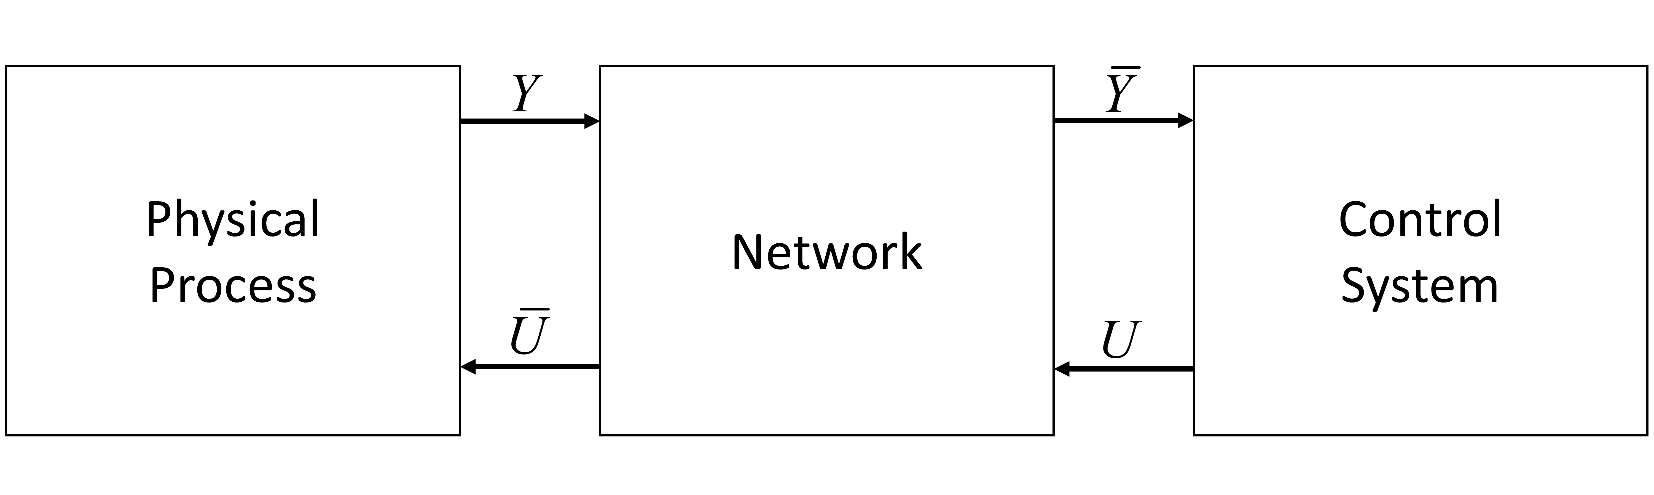
Model of a cyberphysical system

Slide 8
Industrial Wireless Technologies
Performance Estimation, Testing, and Control of Cyber-Physical Systems Employing Non-Ideal Communications Networks
Richard Candell

Slide 10
SysML: Workcell Architectural Decomposition and Analysis
Performance Estimation, Testing, and Control of Cyber-Physical Systems Employing Non-Ideal Communications Networks
Richard Candell

Slide 12
Machine Learning in a Robotic Force Seeking Application
Performance Estimation, Testing, and Control of Cyber-Physical Systems Employing Non-Ideal Communications Networks
Richard Candell

Slide 14
Thoughts and Future Direction
Performance Estimation, Testing, and Control of Cyber-Physical Systems Employing Non-Ideal Communications Networks
Richard Candell

Slide 16
Industrial Wireless Testbed
Performance Estimation, Testing, and Control of Cyber-Physical Systems Employing Non-Ideal Communications Networks
Richard Candell

Slide 17
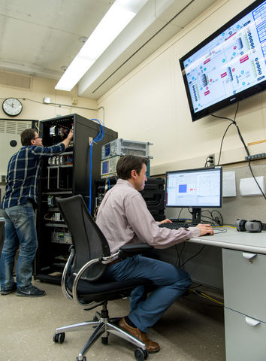
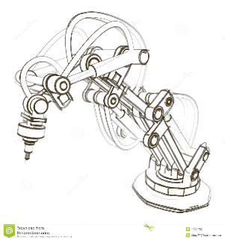
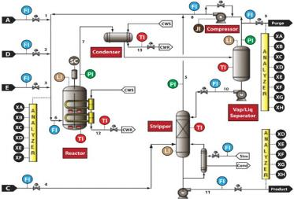
NIST Industrial Wireless Testbed
Process
Control
Discrete
Manufacturing
Slow Processes
e.g. “TESIM” Chemical Reactor
Discrete/Fast Processes
e.g. Mechanical Assembly

Slide 18
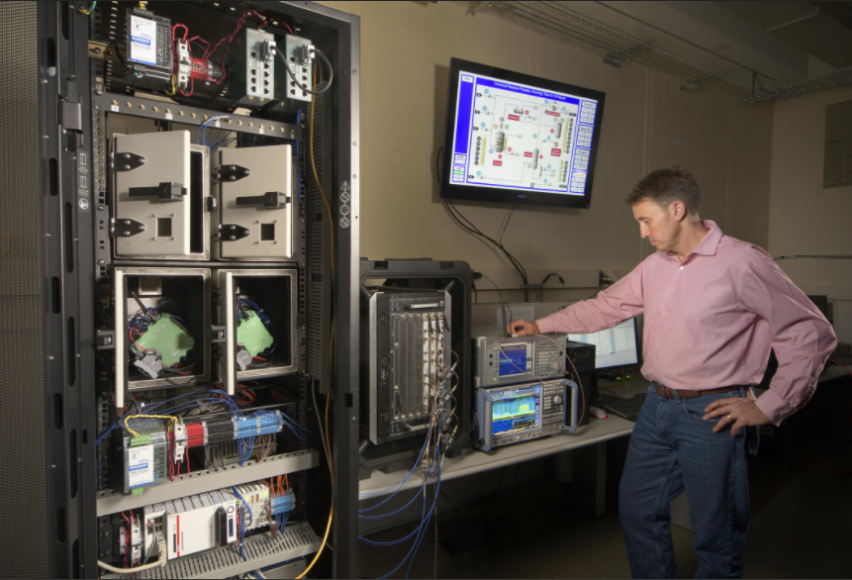
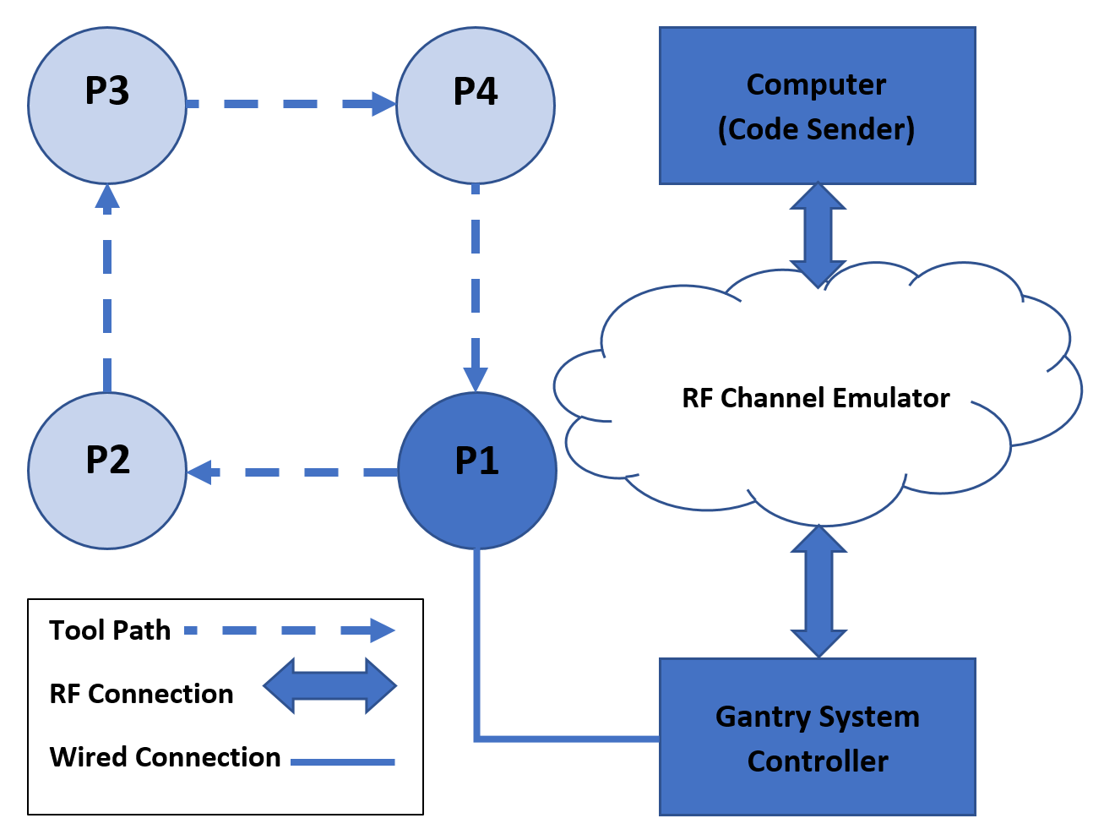
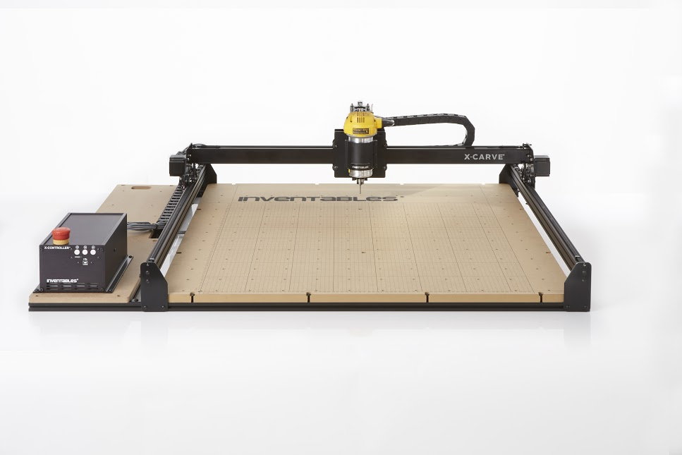
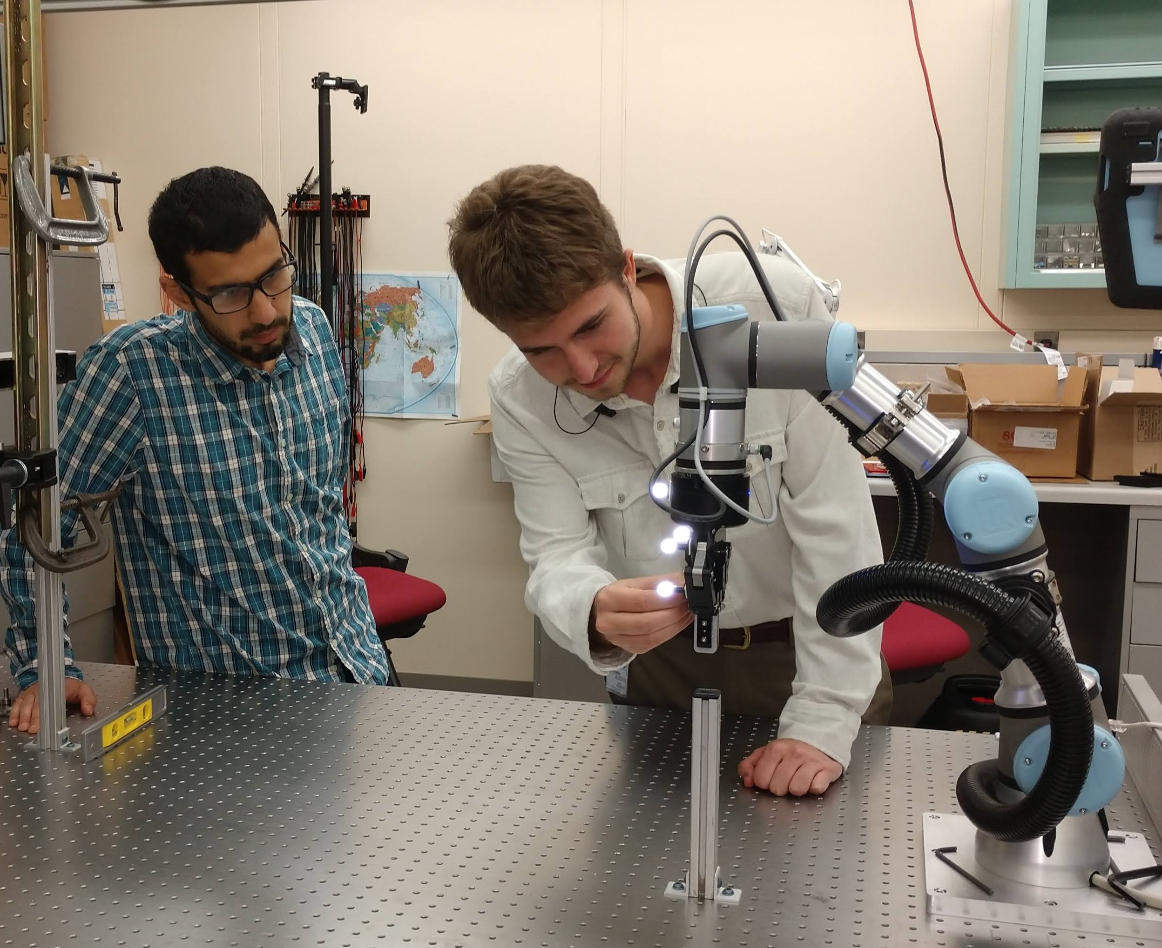
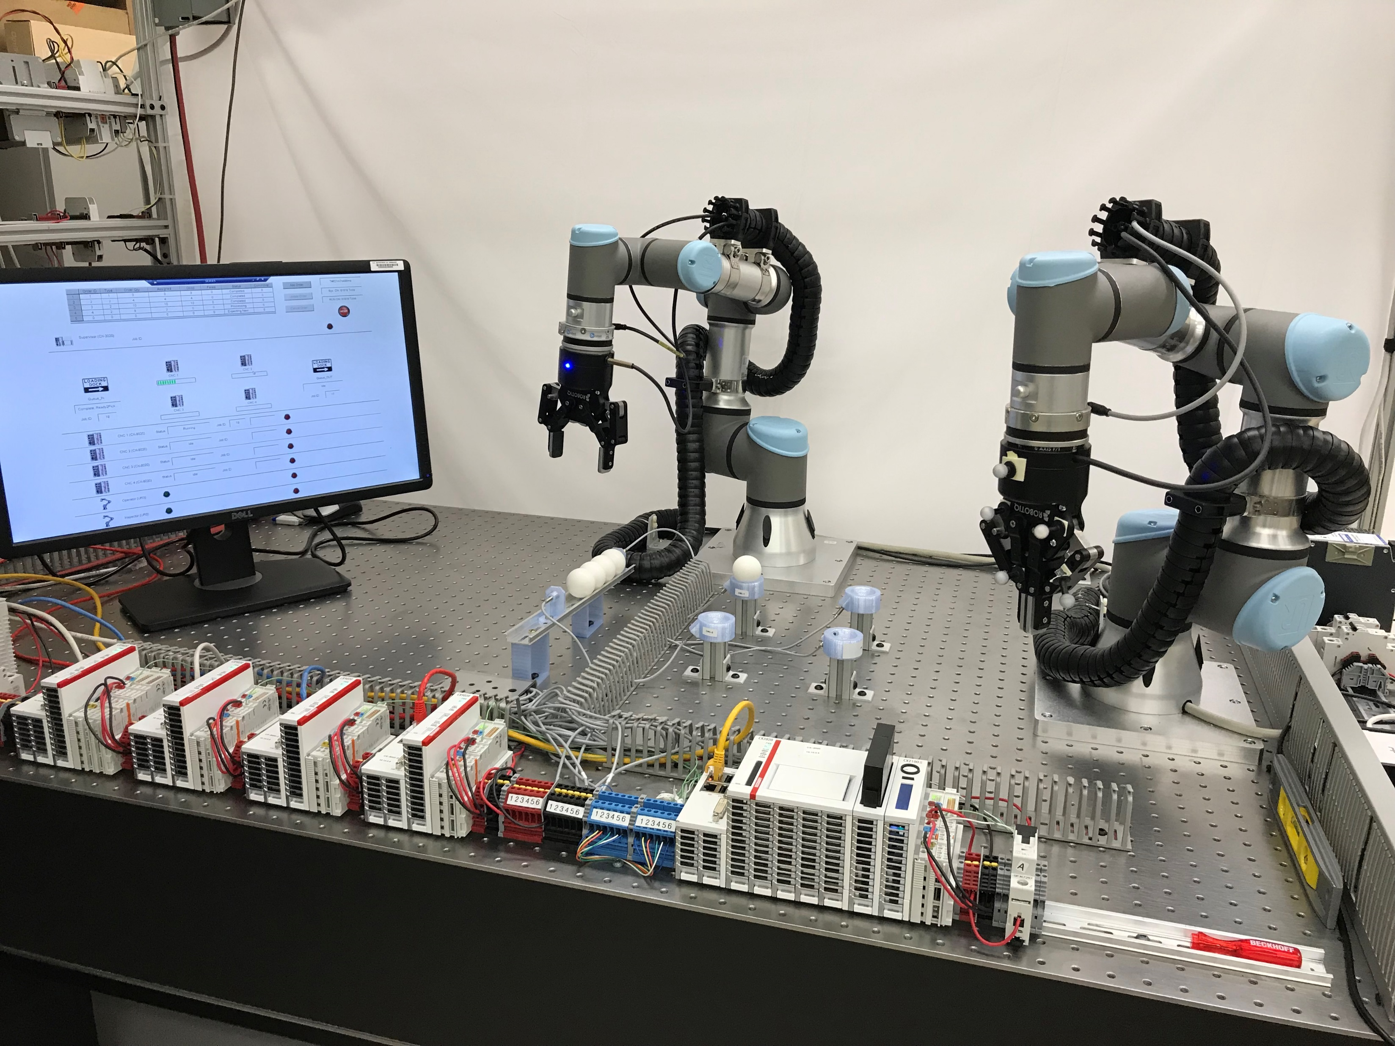
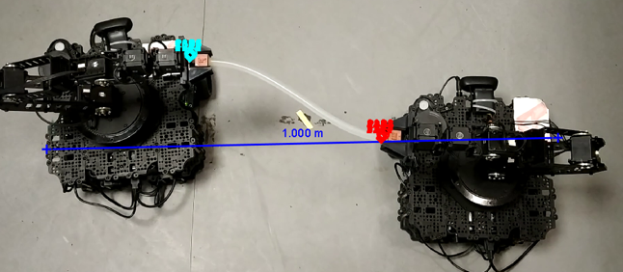
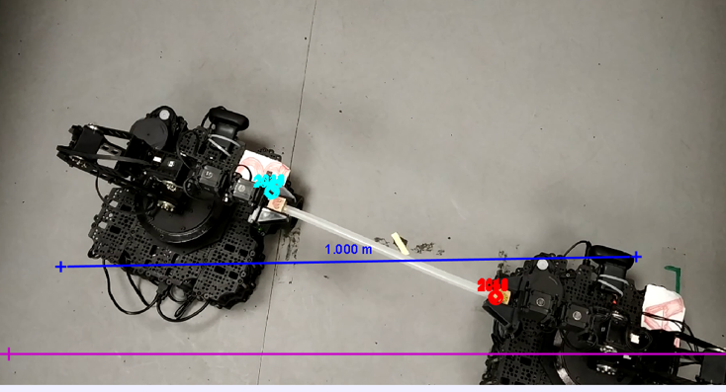
Past Testbed Incarnations
(1)
1 - NIST - Tennessee Eastman chemical plant simulator
2 - NIST - 3D gantry system
3 - NIST - Force seeking apparatus
4 - NIST - Dual-robot machine tending with inspection
5 - Intel Dual-robot tether apparatus using TSN
(3)
(4)
(5)
(2)

Slide 19
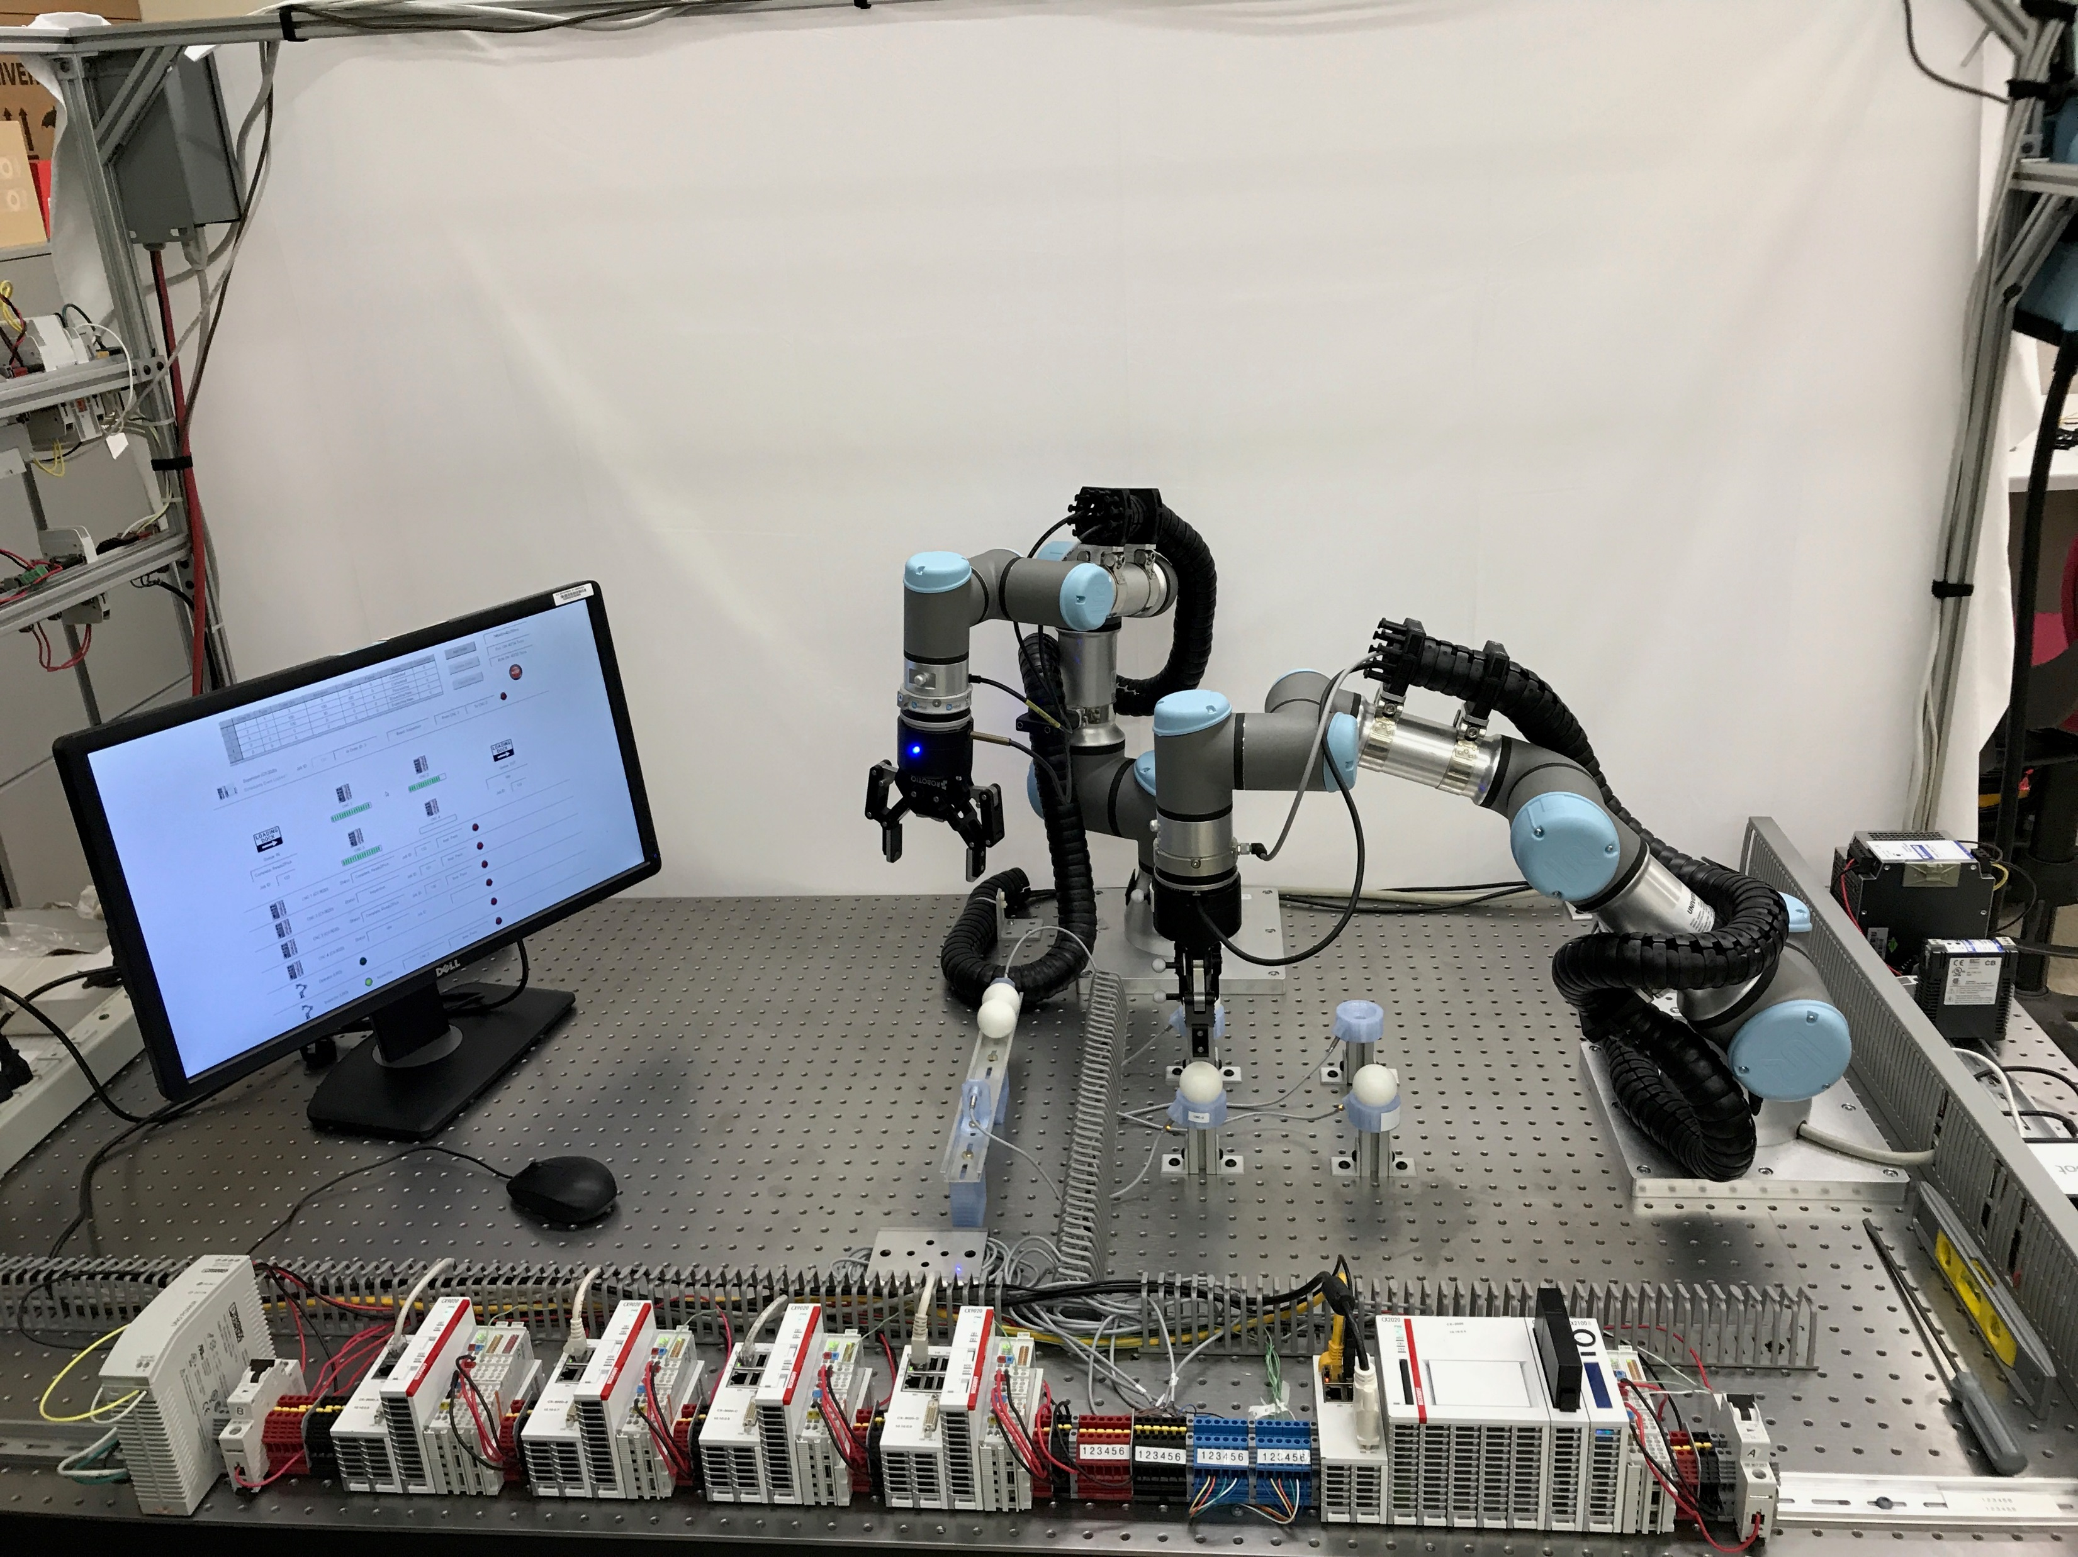
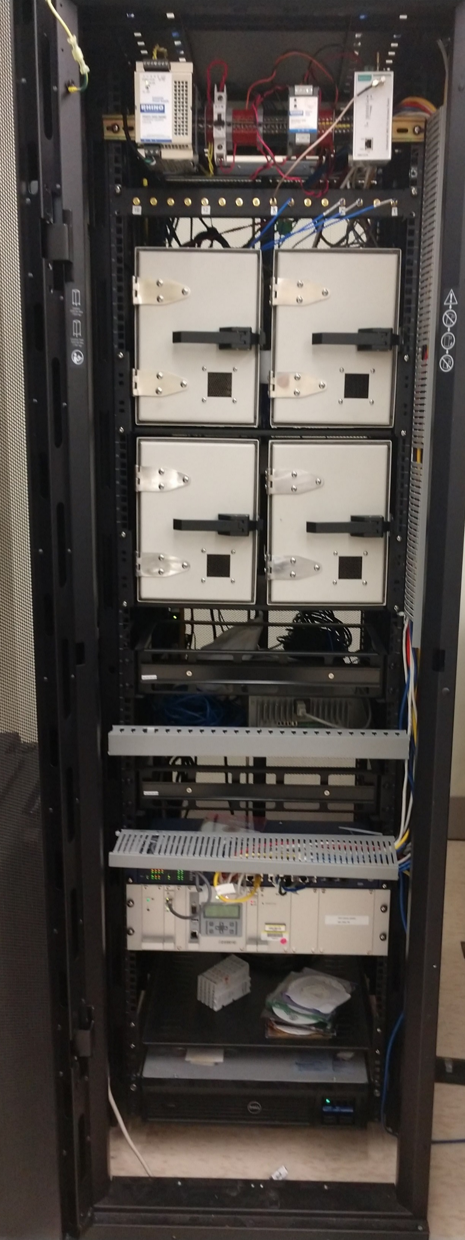
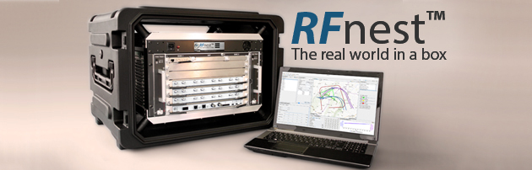
The NIST Industrial Wireless Testbed and Demonstration Platform
Dual Cobots
RF
Shielding
CNC Sims
Supervisor
IEEE 1588 Master
RF Channel Emulator
TSN Capable

Slide 20
Key Capability: RF Channel Emulator
Transmission Delay
Path loss
Multipath
Fading
Interference
Mobility Radios
Mobile Surroundings
Recreates the Factory’s Radio Environment in the Lab

Slide 21
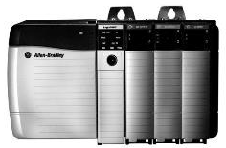


Example: Chemical Reactor Control
Controller
Path Loss
Delays
Multipath
Interference
Actuators
Valve position
ON/OFF
Set-points
Reconfigure
Thresholds
Sensors
Level
Temperature
Pressure
Flow
Composition
Position

